Slide 1
Unit-2 OVERVIEW OF INTELLECTUAL PROPERTY RIGHTS
.

Slide 2
In this unit:
Intellectual Property Rights :
Introduction to IPR,
Types of IPR,
National and International law,
TRIPS agreement,
Registered and unregistered rights,
Civil and criminal law,
IP rights as basic human rights,
Justification for the recognition and enforcement of IP rights,
Jurisdiction and editorial policy
.

Slide 3
Intellectual Property Rights :
Introduction to IPR,
Types of IPR,
National and International law,
.

Slide 4
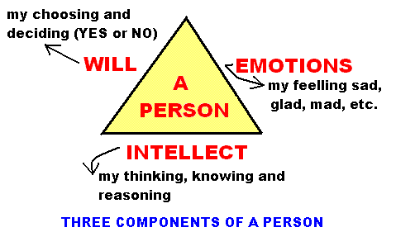

What is intellect ?
Ability of reasoning and understanding objectively, especially with regards to abstract matters.
It is related to “Facts” in contrast to intelligence concerning feelings.
It refers to the thought and rational mental process gained through external input rather than internal.

Slide 5
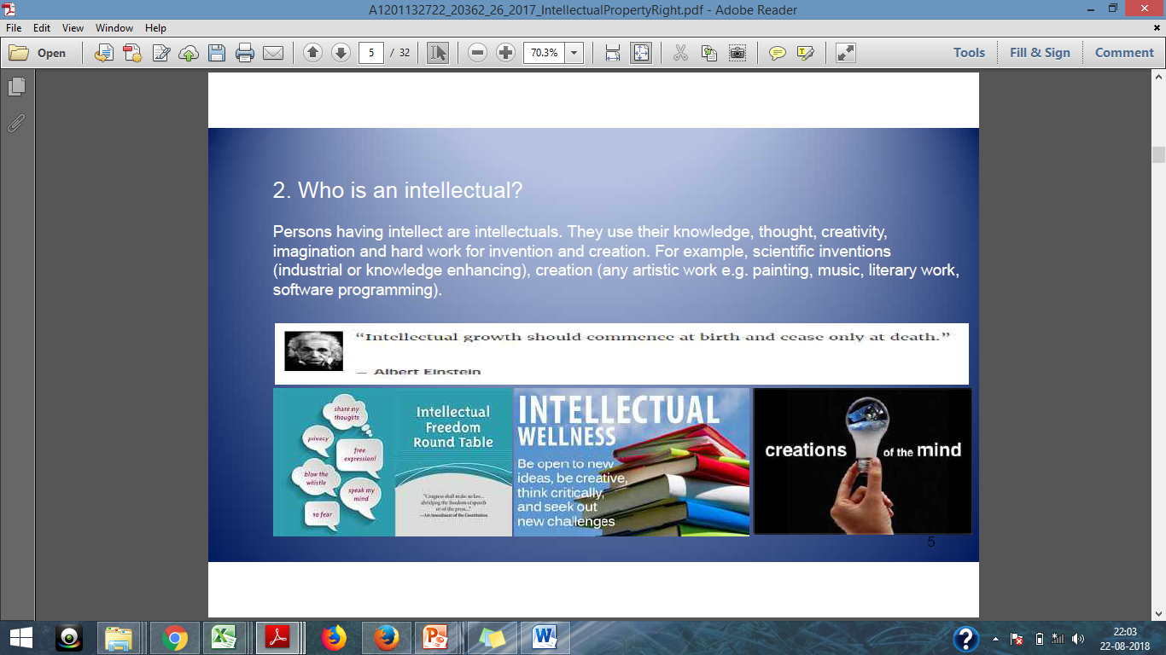
Who is an intellectual ?
Person having intellect are intellectuals.
They use their knowledge, thought, creativity, and imagination for invention and creation.
For example:
Scientific Inventions : Industrial or knowledge enhancing
Creation: any artistic work like painting, music, software program etc.

Slide 6
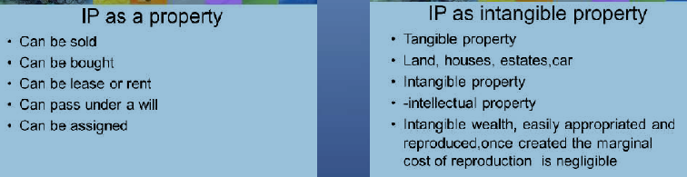
What is Intellectual Property?
IP refers to creation of the mind,
like inventions; literary works; designs; and symbols, name, images used in commerce

Slide 7
What is intellectual property?
Intellectual Property is something produced using human intellect which has commercial value.
Often intangible in nature, but usually contained on a tangible, fixed medium- paper, CD, computer chips…..

Slide 8
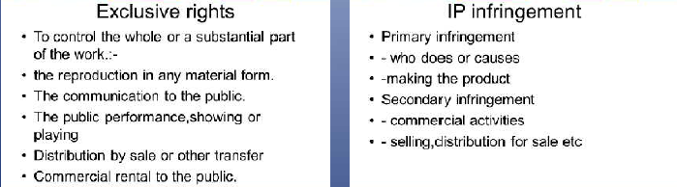
What is Intellectual Property Right(IPR)?
Every intellectual has a right to protect their inventions/ creations.
This right is protected, in law through patents, copyright and trademarks.
The law permits the intellectuals to earn credit, recognition and/or financial assistance for their inventions/ creation.

Slide 9
What is Intellectual Property Right (IPR)?
Intellectual Property Right
not to be confused with IP
it is a right vested in the asset, not the asset itself
e.g.
an idea / invention is IP, a patent registration is an IPR
a customer / price list is IP, a right of confidentiality is an IPR
a secret production method is IP, a right to a trade secret is an IPR
a particular way of representation is IP, copyright or a design registration is an IPR
a brand / trade name is IP, a trade mark registration is an IPR

Slide 10
Intellect and Intellectual are two different things Yes/ No

Slide 11
Consider following statements:
1. A customer list / price list is IP and a right of confidentiality is an IPR
2. A secret production method is IP and right to a trade secret is an IPR
Which of the statement is true:
1 is true
2 is true
Both are true
Both are incorrect

Slide 12

Intellectual Property Rights

Slide 13
Intellectual Property Rights
“INDUSTRIAL PROPERTIES”
PATENTS
INDUSTRIAL DESIGNS
TRADEMARKS
TRADE SECRETS
PLANT VARIETIES
INTEGRATED CIRCUITS
GEOGRAPHICAL INDICATORS
“COPYRIGHT”
LITERARY
NOVEL
POEM
PLAYS
FILMS
MUSICAL
ARTISTIC
DRAWINGS
PHOTOGRAHS
PERFORMING ARTS
SCULPTURES
SOFTWARE

Slide 14
PATENTS
A patent is a legal title granting its holder the exclusive right to make use of an invention for a limited area and time by stopping others from, among other things, making, using or selling it without authorization.
In return for this right, the applicant must disclose how his invention works in sufficient detail.
When a patent is granted, the applicant becomes the owner of the patent. Like any other form of property, a patent can be bought, sold, licensed or mortgaged.
Patents are territorial rights, so an Indian patent will only give the owner rights within India and rights to stop others from importing products into India.

Slide 15
PATENT LAW AND PRACTICES
Guided By The Patents Act,1970 as amended
By The Patents (Amendment ) Act,2005
DISCLOSURE OF ADVANCEMENT
INVENTOR
ASSIGNEE OF THE INVENTOR
THE
PATENT
OFFICE
LEGAL HEIR OF AN INVENTOR/ HIS ASSIGNEE
20 YEARS EXCLUSIVE RIGHT ON ADVANCEMENT

Slide 16
PATENTS
As on date, India is fully in compliance with its international obligations under the Trade-Related Aspects of Intellectual Property Rights (TRIPS) Agreement.
The Patents Act 1970 has undergone three amendments – 1999, 2002 & 2005.
The III Amendment in 2005 has major implications on the following:
Introduction of product patent protection for food, pharmaceutical and chemical inventions.
Examination The “mail box” applications, from January 01, 2005

Slide 17
COPYRIGHT
(Governed by the Copyrights Act,1957)
Copyright in :
Original literary , dramatic, musical and artistic works;
-Computer Software's, Engineering Drawings
Cinematographic films; and
Sound recordings.
Copyright –Right to reproduce , make copy , adaptations and translations as applicable
Term : Usually lifetime of the author until sixty years following the year of death of author
Broadcast Reproduction right – Twenty Five Years
Performers Right- Fifty Years
Authors Rights- Moral Rights-Authorship/Object to Alterations

Slide 18
Some Illustrative Examples of Works
Literary works: Novels, Diaries, Poems
Musical works: Symphonies, Jazz, Improvisation
Choreographic works: Dance, Ballet
Artistic works: Paintings, Engravings, Sculptures
Architectural works: Buildings themselves
Figurative works: Maps, Drawings and Charts of a scientific nature
Cinematographic Works: Movies, Video
Photographic works: Photographs, Photogravures
Program works: Computer Programs

Slide 19
Other Categories of Protectable Works
Derivative works:
A “derivative work” means a work created by translating, arranging musically, transforming, or dramatizing, cinematizing or otherwise adapting a pre-existing work .
To exploit these works, authorization must be obtained from the copyright owner of not only the derivative work, but also of the original work .

Slide 20
COPYRIGHTS
India has a very strong and comprehensive copyright law based on Indian Copyright Act. 1957 which was amended in 1981, 1984, 1992, 1994 and 1999 (w.e.f. January 15, 2000).
The amendment in 1994 were a response to technological changes in the means of Communications like broadcasting and telecasting and the emergence of new technology like computer software.
The 1999 amendments have made the Copyright Act fully compatible with Trade-Related Aspects of Intellectual Property Rights (TRIPS) Agreement & fully reflects Berne Convention.
The amended law has made provisions for the first time, to protect performers’ rights as envisaged in the Rome Convention. With these amendments the Indian Copyright law has become one of the most modern copyright laws in the world.

Slide 21
GEOGRAPHICAL INDICATIONS
(Governed By The Geographical Indication
Of Goods (Registration & Protection)Act,1999 )
An indication used to identify agricultural, natural or manufactured goods originating from a definite territory in India.
It should have a special quality or characteristics based upon the climatic or production characteristics unique to the geographical location.
Eamples of Geographical Indications in India are Darjeeling Tea, Kanchipuram Silk Saree, Alphonso Mango, Nagpur Orange, Kolhapuri Chappal, Bikaneri Bhujia, etc.
Any association of persons, producers, organization established by or under the law can apply representing & protecting the interests of the producers.
The registration of a Geographical Indication is for a period of ten years.
Renewal is possible for further periods of 10 years each.

Slide 22
GEOGRAPHICAL INDICATIONS
India, as a member of the World Trade Organization, enacted the Geographical Indications of Goods (Registration & Protection) Act, 1999 has come into force with effect from 15th September 2003.
The source of Geographical origin is the biological material used in invention is required to be disclosed in the specification.

Slide 23
Protection of New varieties of Plants (To Be Governed By Sui Generis system The Protection Of Plant Varieties and Farmer’s Rights Act, 2001)
NEW PLANT VARIETY:
DISTINCT
UNIFORM and
STABLE
The objectives of the Act are as follows :
To provide for the establishment of an effective system for protection of plant varieties;
To provide for the rights of farmers and plant breeders;
To stimulate investment for research and development and to facilitate growth of the seed industry;
To ensure availability of high quality seeds and planting materials of improved varieties to farmers.

Slide 24
LAYOUT DESIGNS (TOPOGRAPHIES) OF INTEGRATED CIRCUITS [To be governed by The Semiconductor Integrated Circuits Layout Designs Law (SICLD) Act, 2000]
SICLD Act, 2000 is the governing Act for 'Lay Out Designs of Integrated Circuits' in India.
The aim of the Act is to provide protection in the area of Semiconductor Integrated Circuit Layout Designs and for matters connected therewith.
The Act is implemented by the Department of Information Technology, Ministry of Information Technology.
The Semiconductor Integrated Circuits Layout-Design Registry (SICLDR) is the office where the applications on Layout-Designs of integrated circuits are filed for registration of created IPR.
The Registry has jurisdiction all over India.

Slide 25


TRADEMARKS (Governed By The Trade Marks Act,1999)
OLYMPUS
SONY
A trade mark is any sign which can distinguish the goods of one trader from those of another. Sign includes, words, logos, pictures, or a combination of these.
A trade mark is used as a marketing tool so that customers can recognize the product of a particular trader.
To register a trade mark , the mark must be:-
distinctive, and, not deceptive, or contrary to law or morality, and, not identical or similar to any earlier marks for the same or similar goods.

Slide 26
Variety of Trademarks
Variety of Trademarks | Meaning | Example
Fanciful Trademarks | Invented Words | Polaroid and Kodak, Starbucks
Arbitrary Trademarks | Having real meaning but no relation to goods | Apple
Suggestive Trademarks | Give hint of the project | Jaguar
Descriptive trademarks | description of the product or service. | Sharp

Slide 27

DESIGNS ACT 2000
(Came In To Force On 11-05-2001)
APPLIED TO
ANY ARTICLE OF MANUFACTURE IN TWO DIMENESION OR THREE DIMENSION OR IN BOTH FORM

Slide 28
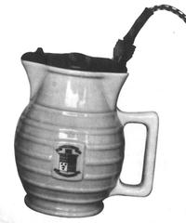
Industrial Designs
The protection you receive is only for the appearance of the article and not how it works.
Design registration is intended to protect designs which have an industrial or commercial use.
Duration of protection is initially for 10 years and extendable for another term of 5 years.
Designs of stamps, labels, tokens, cards, cartoons, or parts of an article not sold separately, cannot be registered.
Electrical JUG

Slide 29
Which way the Intellectual property right can be protected? a. Patent b. Copyright c. Trademark d. All of the above

Slide 30
The trademark Apple is an arbitrary trademark: True False

Slide 31
The protection of Industrial design is received only for the appearance of the article and not how it works.
True False

Slide 32
Fifteen years ago, Companies:
Competed on : Price
Today it’s : Quality
Tomorrow it’s : Designs
When companies are competing at equal price & functionality, Design is the only differential that matters”
– Mark Dziersk,
quoted in TIME Magazine

Slide 33
TECHNICAL ADVANCEMENT BY WAY OF A NEW PRODUCT OR A NEW PROCESS NOT LIMITED TO OUTER VISUAL APPEAL
KEEP IT SECRET
DISCLOSE TO OTHERS

Slide 34
CONFIDENTIAL INFORMATION
&
TRADE SECRETS
Secret
MANUFACTURING AND COMMERCIAL SECRETS
Commercial
Value
Steps Taken
To Keep It
Secret
Consumer Profiles
Distribution Methods
Manufacturing Processes
Advertising Strategies

Slide 35

TRADE SECRET
A typical example is Coca-Cola. This soft drink was invented in 1886 and was never protected by a patent, only by a trademark (for the name Coca-Cola) and by an industrial design (for this very special design of the Coca-Cola bottle, supposed to be in the shape of a woman wearing a long skin-tight dress).
The process of the Coca-Cola drink is secret and is only known by two persons in the world. They are not allowed to travel together, so that there is no chance of them dying at the same time in an accident. The secret of the Coca-Cola process was well kept during all these years, and nobody is able to produce a drink with exactly the same taste still today. You all know that Pepsi Cola, its biggest competitor, has a different taste.

